Slide 1
ANOVA
- Comparing means

Slide 2
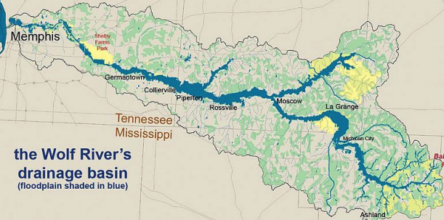
The Wolf River in Tennessee flows past an abandoned site once used by the pesticide industry for dumping wastes, including chlordane (pesticide), aldrin, and dieldrin (both insecticides)
These highly toxic organic compounds can cause various cancers and birth defects
The standard methods to test whether these substances are present in a river is to take samples at six-tenths depth
But since these compounds are denser than water and their molecules tend to stick to particles of sediment, they are more likely to be found in higher concentrations near the bottom

Slide 3
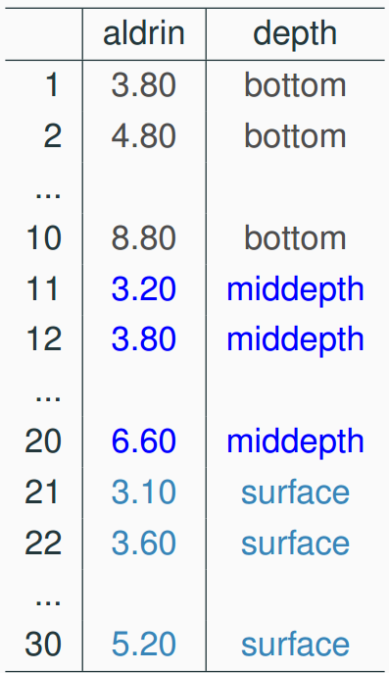
Data
Aldrin concentration (nanograms per liter) at three levels of depth

Slide 4
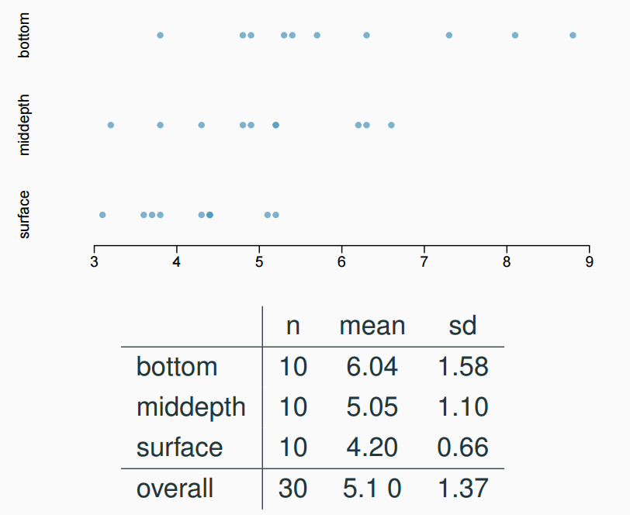
Exploratory analysis
Aldrin concentration (nanograms per liter) at three levels of depth

Slide 5
Research question
Is there a difference between the mean aldrin concentrations among the three levels?

Slide 6
ANOVA
ANOVA is used to assess whether the means are different for different levels of a categorical variable.
H₀ : The mean outcome is the same across all categories
𝜇₁ = 𝜇₂ = … = 𝜇_{k}
H_{A} : At least one mean is different than others

Slide 7
Conditions
The observations should be independent within and between groups
The observations within each group should be nearly normal
Especially important when the sample sizes are small
Use histogram or other visualization
The variability across the groups should be about equal
Especially important when the sample sizes differ between groups
Use boxplot or other visualization

Slide 8
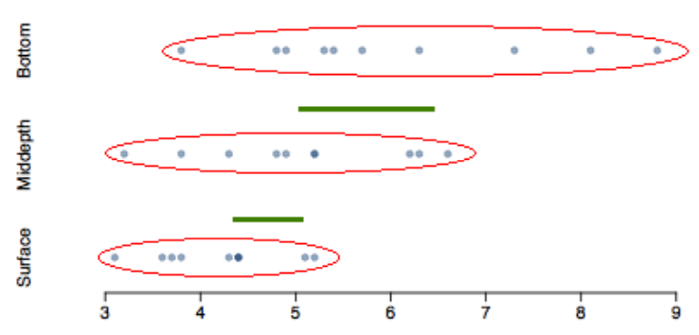
Variability
Does there appear to be a lot of variability within groups? How about between groups?

Slide 9
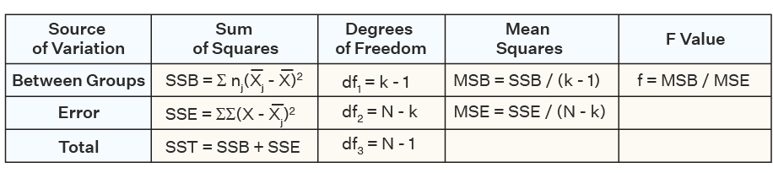
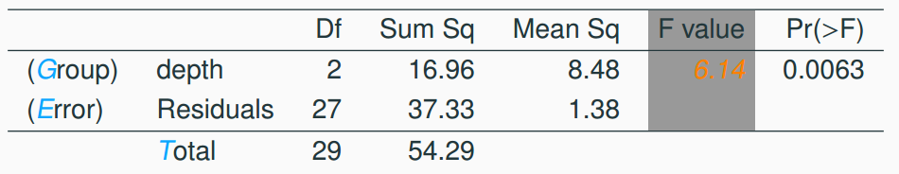
ANOVA

Slide 10
p-value
Since p-value (0.0063) is less than the significance level of 0.05, we reject Ho.
The data provide convincing evidence that the average aldrin concentration is different for at least one group.

